Slide 1

Project Progress Presentation
A Web GIS application for integration of socio-economic, biophysical and atmospheric variables: A case study of Punjab province
Presented by: Syed Mustafa Haider and Akram Ali Shah
Department: Space Science
Batch: 5

Slide 2
Content
Recalling of the project essentials
Summary of the project progress as of now
Literature review
Data collection
Methodology for data collection
Thematic map creation
Methodology for creation of thematic map
Prototype webpage
Project timeline
Utilization

Slide 3
Recalling of the project essentials
The aim of this project was to develop a geospatial web application for the facilitation of data analysis and presentation.
The study area chosen for this project was the province Punjab, Pakistan.
The data to be visualized on our webpage consisted of the following selected Parameters i.e. Land Surface Temperature (LST), Population, Precipitation and Air Quality Parameter
The final webpage would be responsive and dynamic

Slide 4
Summary of the Project Progress as of now
Milestone | Deliverable | Current progress.
Literature Review | Summary of the work done in relevant field | 9 journal articles and 2 Research papers were studied in order to incorporate and update their features into our project.
Data Collection | Collection of Satellite Data Products | Data regarding LST and Population has been collected. The data regarding the other 2 parameters is being collected.
Analysis of data/Creation of thematic maps | Thematic maps and graphs(if required) | The Choropleth map of Population Density of Punjab has been created
Web portal designing and development | Geospatial web portal | Prototype along with various other sample webpages have been created
Writing thesis and research paper | Final year project report | Work has been documented in separate word documents. No official report document as of now.

Slide 5
Literature Review
FEATURES | D. S. Rathore, D. Chalisgaonkar, R. P. Pandey, T. Ahmad, and Y. Singh, “A Web GIS Application for Dams and Drought in India,” J. Indian Soc. Remote Sens., vol. 38, no. 4, pp. 670–673, 2010, doi: 10.1007/s12524-010-0054-2. | K. Observatory, C. Istanbul, T. Land, F. Command, and C. E. Faculty, “Developing a Web-Based Gis Application for Earthquake Information,” Civ. Eng., pp. 1–4, 2002 | I. Machdar, T. Zulfikar, R. S. Oktari, H. Fahlevi, and W. Irawati, “Assessment of post-tsunami disaster recovery of Banda Aceh city of Indonesia as window of opportunities for sustainable development Assessment of post-tsunami disaster recovery of Banda Aceh city of Indonesia as window of opportunities for sustainable dev,” pp. 0–11, 2004, doi: 10.1088/1755-1315/56/1/0120. | A. Noor Anna, Rudiyanto, and V. Nahdhiyatul Fikriyah, “Environmental pollution monitoring using a Web-based GIS in Surakarta,” IOP Conf. Ser. Earth Environ. Sci., vol. 314, no. 1, 2019, doi: 10.1088/1755-1315/314/1/012066 | L. Van Trung and D. M. Tam, “Web GIS Solution for Monitoring the Forest-Cover in the Mekong Delta, Vietnam,” J. Geogr. Inf. Syst., vol. 10, no. 05, pp. 491–502, 2018, doi: 10.4236/jgis.2018.105026 | A Web GIS application for integration of socio-economic, biophysical and atmospheric variables: A case study of Punjab province
Data downloading |  |  |  |  |  | 
Dynamic maps and webpage. |  |  |  |  |  | 
Graphical representations of data |  |  |  |  |  | 
Database |  |  |  |  |  | 
User provided data |  |  |  |  |  | 
Real-time Spatial data analysis |  |  |  |  |  | 
Map navigation menu(map tools) |  |  |  |  |  | 
Temporal data analysis |  |  |  |  |  | 
Thematic maps |  |  |  |  |  | 

Slide 6
Data collection
The data of Population density and Land Surface Temperature has been collected successfully .
The data of Air quality index and precipitation is being collected.
NASA AppEEARS-USGS was used to collect LST and Population data
Population
Gridded Population of the World (GPW)
Time Range: 2010,2015,2020
LST
16 days MODIS data for June and December
Time Range: 2010-2019

Slide 7
Methodology for data collection
Downloading data
Compiling and arranging data
Joining data with the shapefile

Slide 8
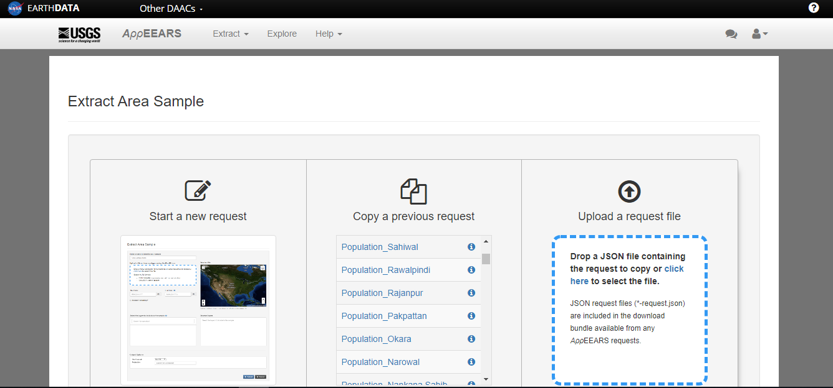
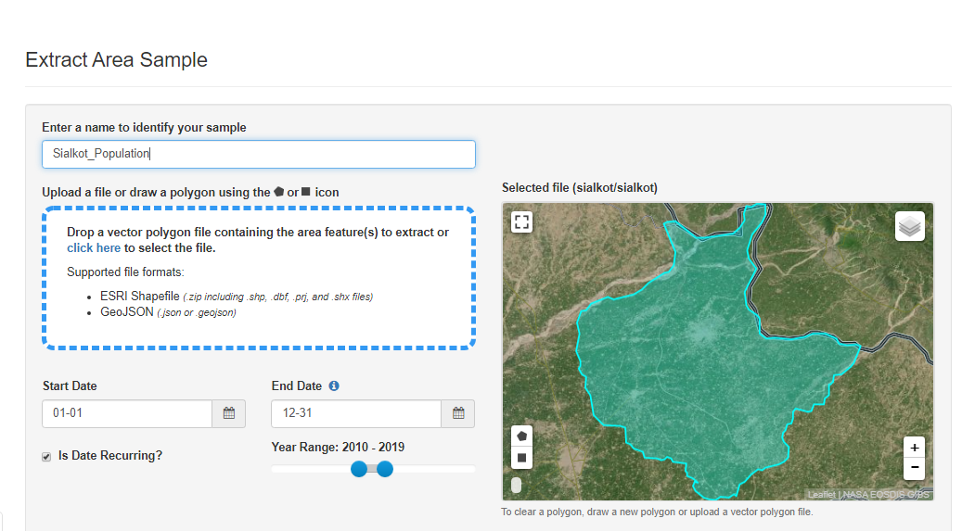
Methodology

Slide 9
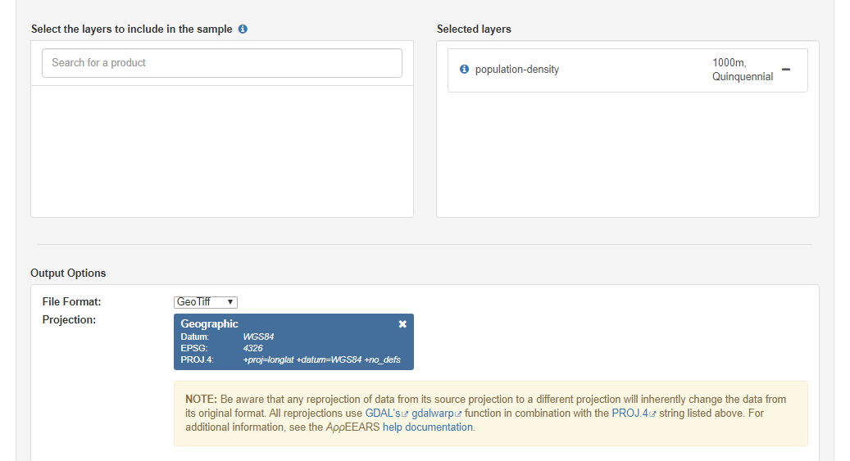
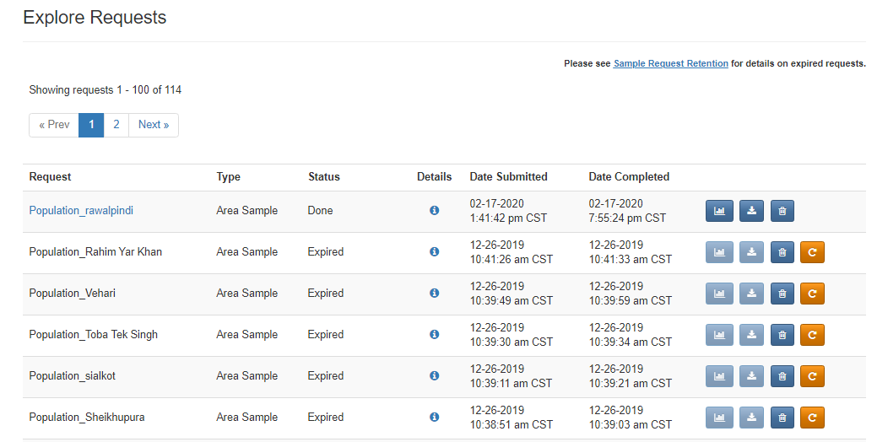

Slide 10
Thematic Map creation
Thematic map of the population of Punjab for the years 2010, 2015 and 2020 has been created and displayed on the webpage
Initially the map was created on ArcMap software for reference.
The type of thematic map created to visualize the population over the years was the Choropleth map.
Type of Thematic Map | Parameters
Choropleth | Population density
Dot proportion | LST
Dot density | Precipitation
Symbol map | Air Quality parameter

Slide 11
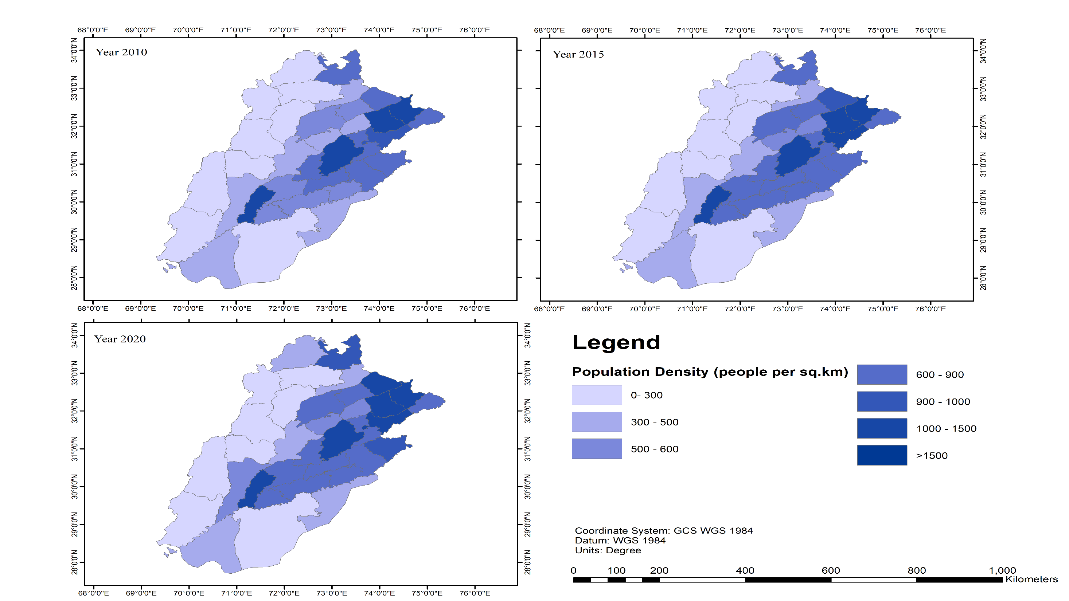
Methodology for creation of thematic map
Joining the excel data with the shapefile
Exporting the data and saving it as a separate shapefile
Create Thematic map on ArcMap for reference

Slide 12
Methodology for creating the prototype webpage
Conversion of the shapefile into the Geojson format
Assigning a variable to the GeoJson file.
Incorporating the variable into the webpage through JavaScript

Slide 13
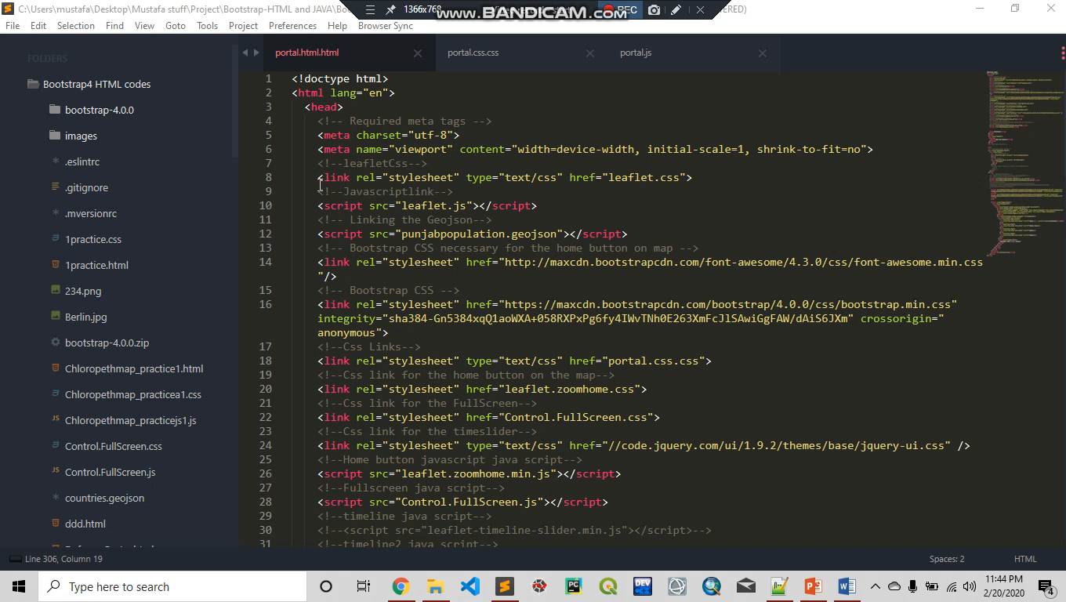

Slide 14





Project timeline
Ongoing
2 months
3 months
3 months
1 months
Literature review
Data Collection
Analysis of data/Creation of thematic maps
Web portal designing and development
Final year report

Slide 15
Utilization
This Geospatial Portal can be utilized as a decision support system in case of decisions regarding bio-physical ,socio-economic factors of Punjab.
Environmental organizations can make use of this geospatial portal in order to create methods for controlling pollution and managing population, etc.
For the sake of research

